Slide 2
NCM: Beyond Pancakes
Campaign Wrap Report 12.18.19

Slide 3
Background

Slide 4
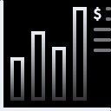
media Plan
Media Plan
Campaign Summary
Campaign Summary
11.8MM |  | National |  | 10/18-10/31
Impressions |  | DMA |  | Flight Dates
Beyond Pancakes
Primary KPI
Incremental foot traffic to Beyond Pancakes locations nationwide.

Slide 5
Executive Summary

Slide 6
Campaign Summary
Beyond Pancakes
6,541,876
11,775,378
14%
39,118
MOVIE ATTENDANCE
TICKETS SOLD
LIFT IN FOOT TRAFFIC
INCREMENTAL VISITS

Slide 7
14% Lift (1.58 incr. visit rate)
Performance
Per every 1,000 consumers exposed to an ad, there were roughly 4.27 visits.
This resulted in 39,118 incremental visits throughout the duration of the campaign.
We measured a 14% attributable lift between exposed and control visits to Beyond Pancakes at the overall campaign level.
Control Visits
exposed Visits
3.74
4.27
Did not see
the Ad
Saw
the Ad
Campaign Metrics | $179,258 Spend | 6,541,876 Unique Exposures
Return | $469K Incremental Revenue | $12 revenue per visit, assumed by Foursquare
Store Visits | 314,626 Exposed Visits 275,508 Control Visits | 39,118 Incremental Visits

Slide 8
Overall Flighting & Markets

Slide 9
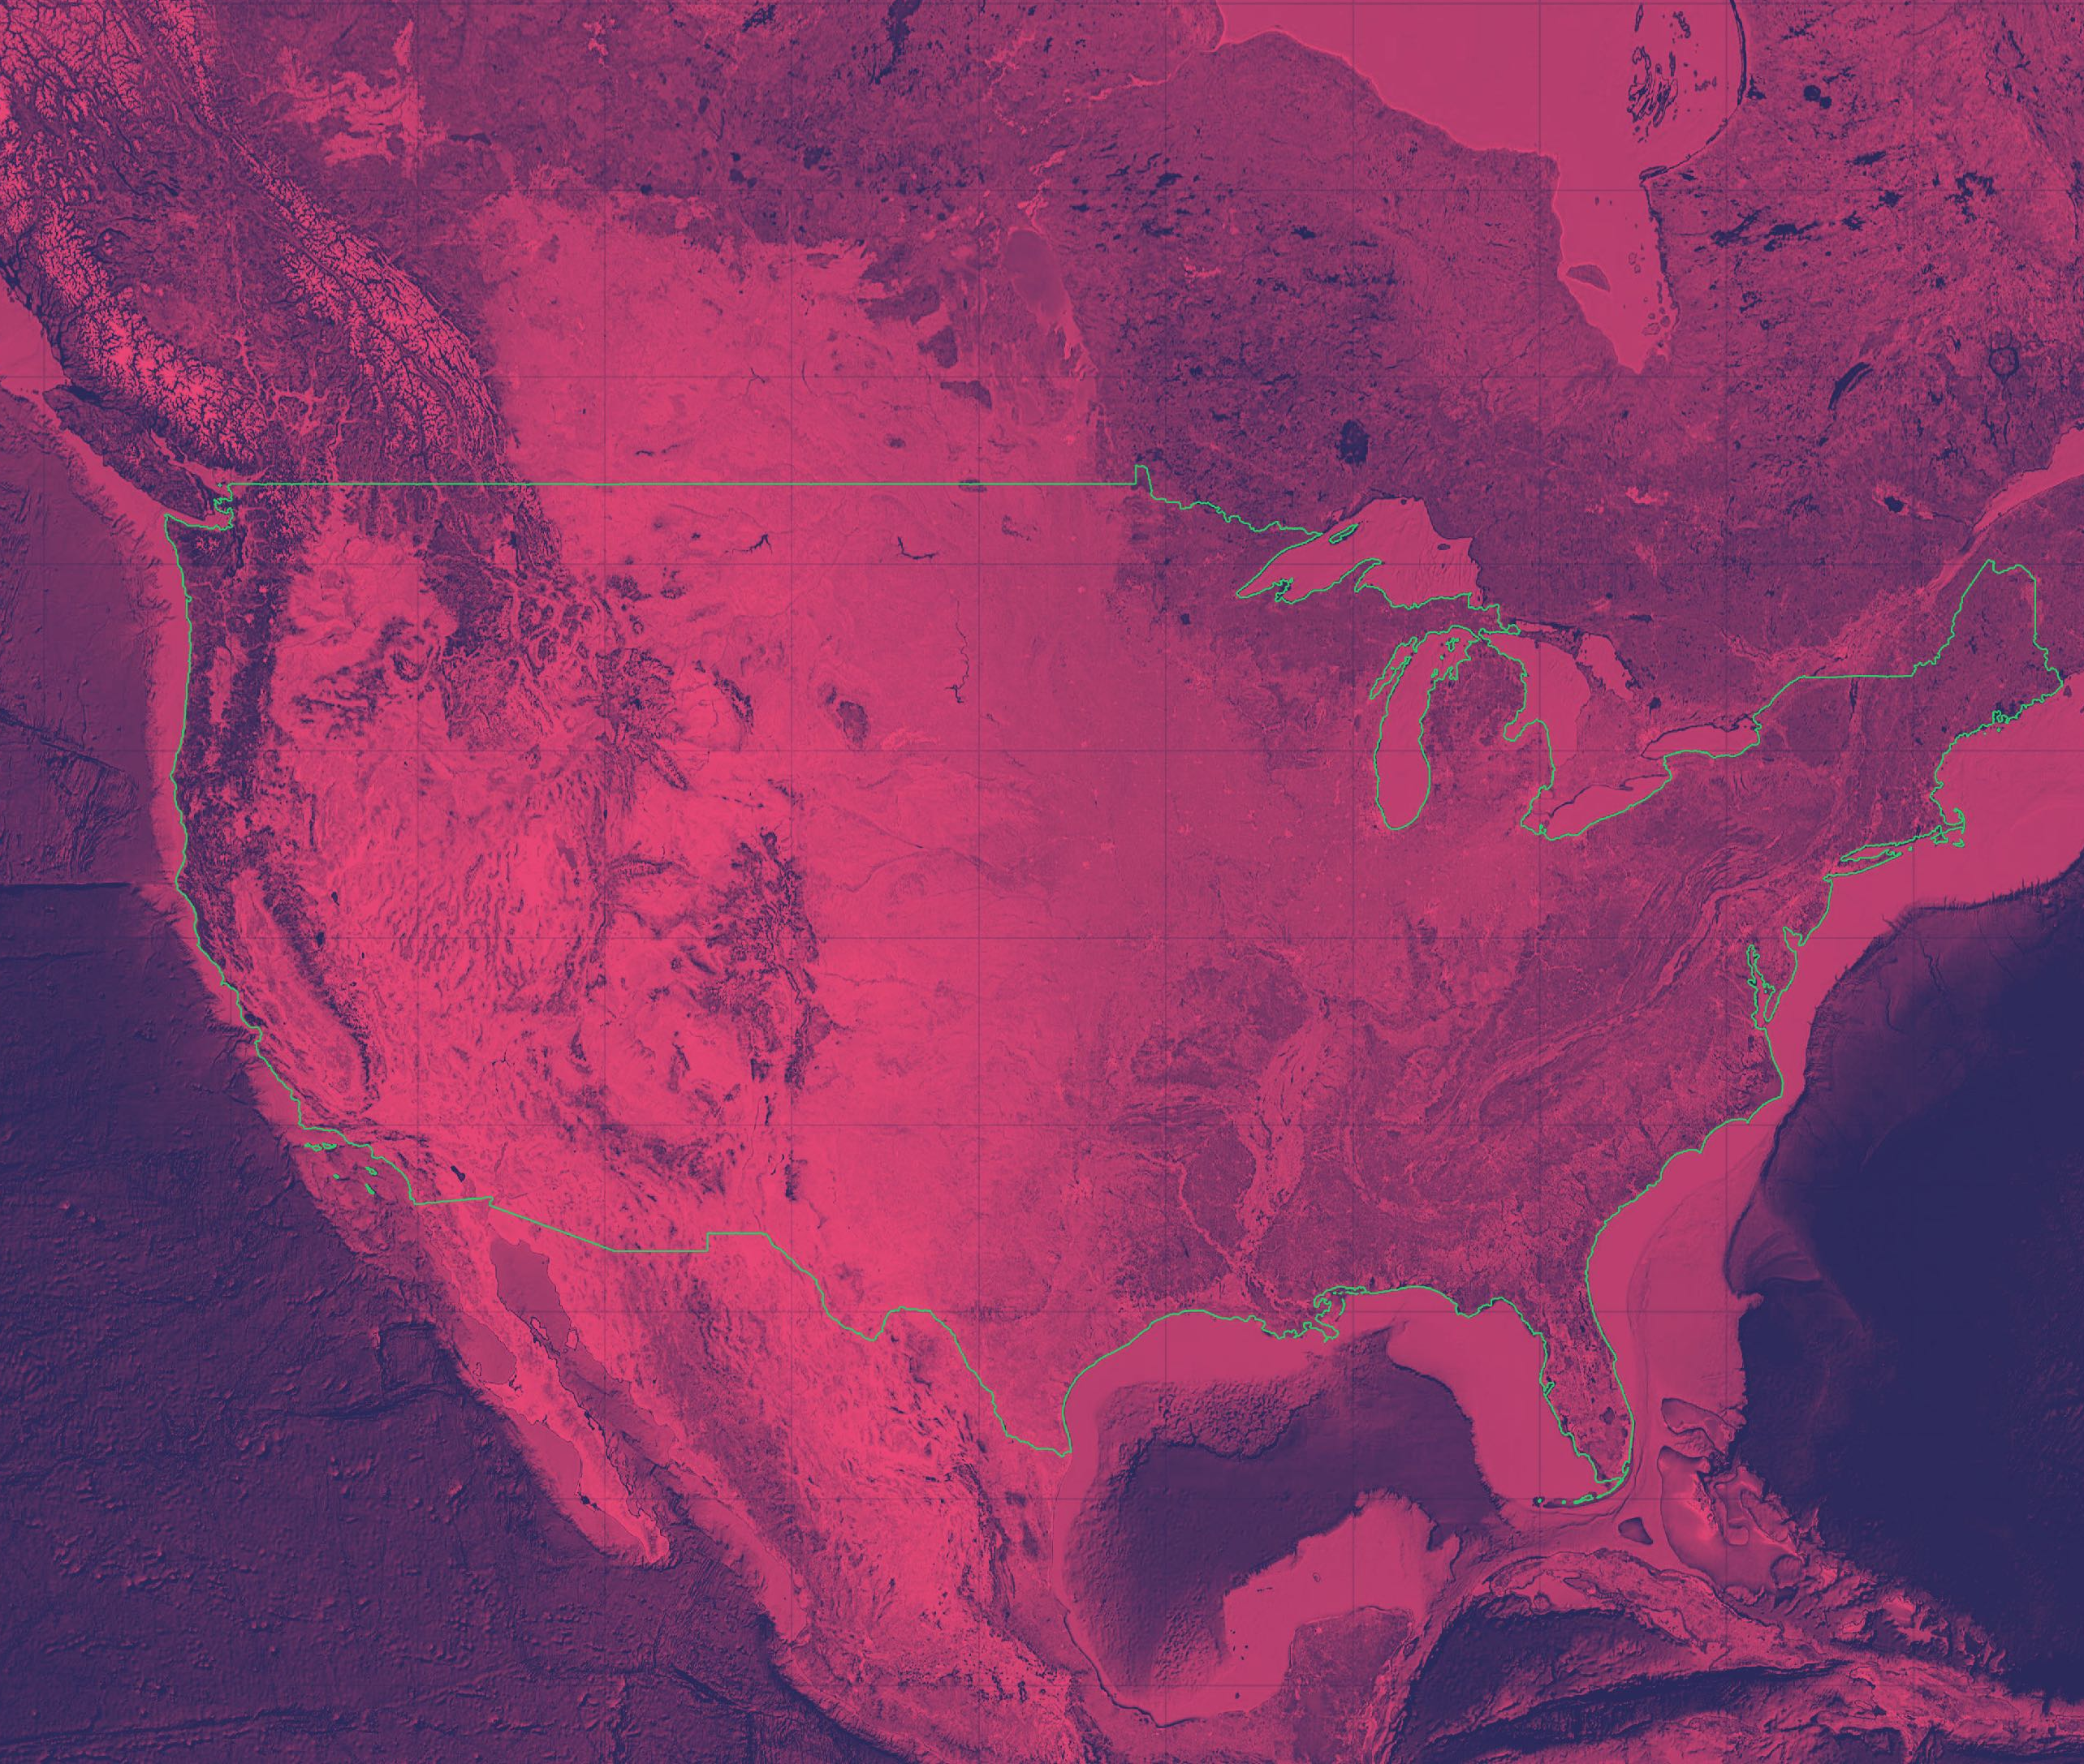
DMAs Overall
flighting & markets
The DMAs listed below experienced the highest foot traffic among exposed consumers during the campaign. The map to the right reflects the most visited DMAs where ad exposure resulted in incremental visitation:
New York | 14%
Los Angeles | 5%
San Antonio, TX | 20%
Philadelphia, PA | 28%
Chicago, IL | 5%
Tampa, FL | 11%
Denver, CO | 29%

Slide 10
Days of the Week OVERALL
flighting & markets
Consumers who were exposed to an ad were more likely to visit an Beyond Pancakes location during the same day of ad exposure.
Throughout the campaign, incremental lift was most notable on Tuesdays, followed by Thursdays and Fridays.
Monday | Tuesday | Wednesday | Thursday | Friday | Saturday | Sunday
14% LIFT | 23% LIFT | 14% LIFT | 17% LIFT | 16% LIFT | 15% LIFT | 7% LIFT

Slide 11
Audience Insights

Slide 12
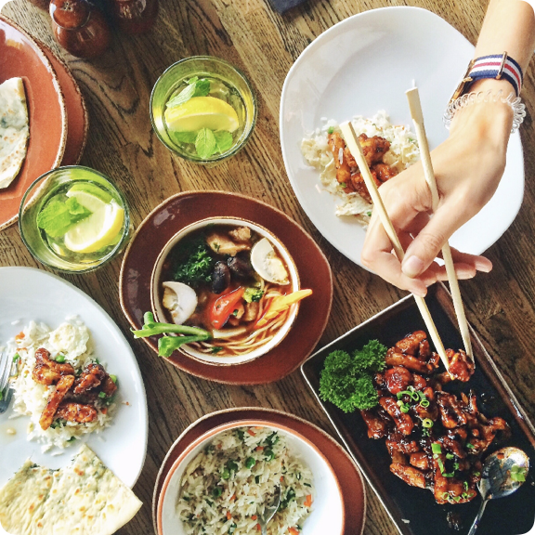
Audience Profiles
audience insights
Foursquare identified three key visitor personas by assessing the behaviors of those exposed to the campaign who then visited a Beyond Pancakes location.
Young Parents |  | Ethnic Food Lovers |  | Discount Shoppers
Kid’s Stores | 1.3x | Tex-Mex Restaurants | 1.5x | Burlington | 1.6c
Frozen Yogurt Shops | 1.3x | South American Restaurants | 1.3x | Family Dollar | 1.6x
Middle Schools | 1.2x | Filipino Restaurants | 1.3x | Ross Dress for Less | 1.6x
Theme Parks | 1.2x | Cuban Restaurants | 1.3x | Dollar General | 1.4x

Slide 13
Age Breakdown
Gender Breakdown
Demographics
audience insights
Exposed Beyond Pancakes visitors skew female and between the ages 25-44.
Foursquare modeling suggests that females and consumers 35+ were most reactive to the campaign messaging.
AGE | LIFT
18-24 | 7%
25-34 | 12%
35-44 | 14%
45-54 | 17%
55-64 | 17%
GENDER | LIFT
Female | 16%
Male | 10%
13￼

Slide 14
Loyalty Data
Customer Loyalty
audience insights
The majority of exposed visits came from new/lapsed visitors.
The campaign was most successful in driving incremental lift among new visitors relative to the unexposed control group.
Have visited
in past 30 days
Have visited
in past 60 days
Have not visited
in past 60 days
Recency | Lift
Regular | 1%
Occasional | 7%
New/Lapsed | 21%
14￼

Slide 15
Thank you

Slide 16
Glossary
Exposed | Users who were exposed to campaign, and matched to Foursquare panel
ML Control | Machine-learned control; expected visit rates are calculated for the exposed group based on their profile in terms of 500+ attributes that are known to predict visit behavior (e.g., demographics, visit history, distance f rom store, etc.)
Visit Rate | Visits per audience segment during campaign (within lookback window)
Total Visits | Exposed Visit Rate during campaign extrapolated to Device ID
Lift | Variance between Exposed visit rate and ML Control visit rate
Incremental Visits | Visits derived from Exposed visit rate minus ML Control visit rate; visits attributable to marketing, resulting from exposure
Categories | A group of venues (Bakeries, Hotels, etc.)
Chains | A group of venues associated with a given brand / property
Tastes | User-selected tastes added to their profiles and associated with venues

